Slide 1
AcademiBalance: An AI‑Driven Faculty Workload Time Allocation Assistant Tools: Excel, Power BI, Microsoft Copilot
Dr. Priya . A - Brindavan College · AICW 2026

Slide 2
Motivation & Problem
Current practice: Focus on raw teaching hours.
Complexity of programmes and batch size often ignored.
Leads to hidden overload / under‑load across faculty.
Need: simple, visual, evidence‑based tool for HODs.

Slide 3
Data, Metrics & Scope
Data:
Real workload data from about 30–40 faculty, expanded to 70 records for richer analysis.
Coverage across B.Com, BBA, BBA Aviation, BCA, B.Sc and Languages.
Core metrics:
Total Workload Hours (TWH).
Complexity‑Adjusted Hours (CAH).
Student‑Adjusted Load Index (SALI)

Slide 4
Methodology & Classification
Excel: data cleaning, validation, and metric formulas.
Power BI: model, DAX measures, dashboard and what-if analysis.
SALI classification:
> 900 – Overloaded
600–900 – Balanced
< 600 – Under‑loaded

Slide 5
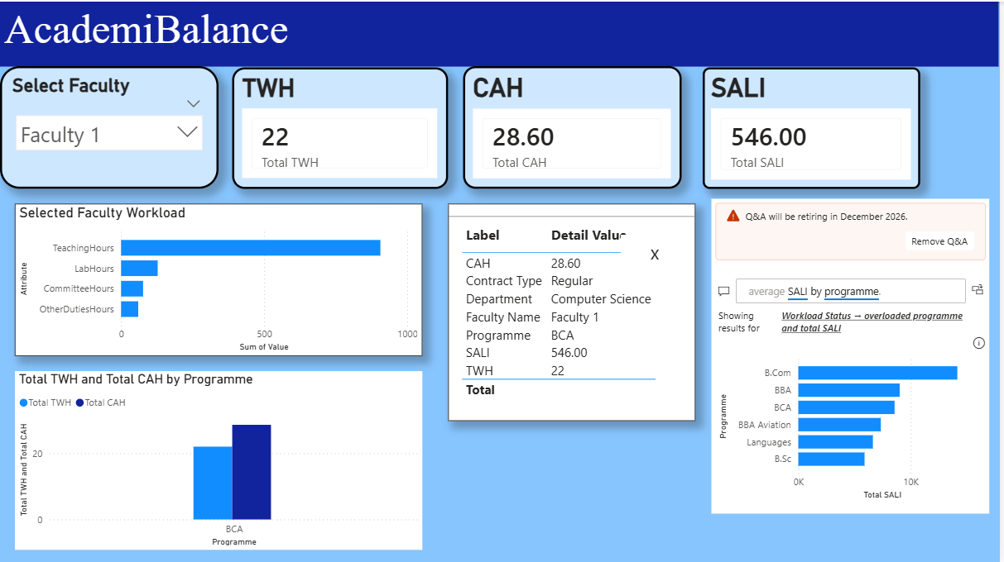
Dashboard, Workflow & Chatbot
Interactive dashboard built in Power BI.
Includes KPI cards, programme-wise charts, faculty-wise tables, and filters for department, programme, semester, and contract type.
Supports both summary-level and faculty-level analysis

Slide 6
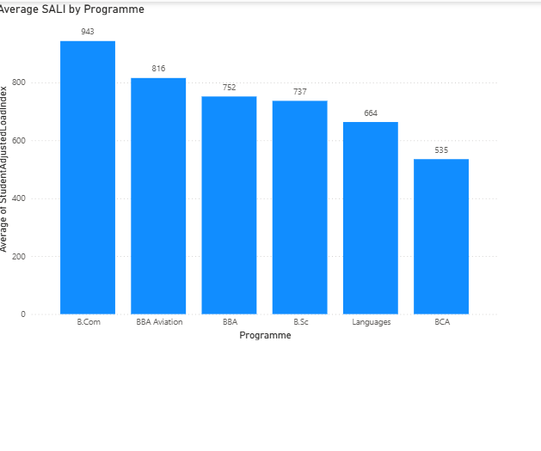
Key Findings
B.Com, BBA, BBA Aviation: higher average SALI than Languages/BCA.
Several regular B.Com and BBA/BBA Aviation faculty flagged as overloaded.
SALI classification (subset n=37):
7 overloaded, 23 balanced, 7 under‑loaded

Slide 7
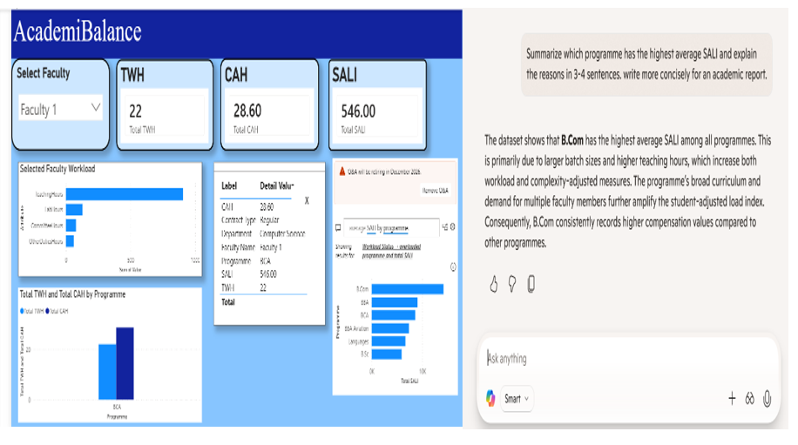
AI, Automation & Chatbot
Microsoft Copilot generates workload summaries in natural language.
Microsoft Forms and Power Automate support low-maintenance data updates and dashboard refresh.
Chatbot layer enables natural-language questions such as overloaded faculty, highest SALI programme, or workload status

Slide 8
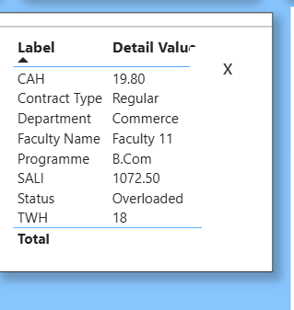
Faculty View & Planning Use Cases
Faculty-level view displays individual workload metrics, status, and assigned responsibilities for closer review.
It helps Heads of Department identify overloaded, balanced, or under-utilised faculty using TWH, CAH, and SALI indicators.
The planning use case supports evidence-based redistribution of courses and duties before timetables are finalised.
This makes workload allocation more transparent, fair, and scenario-based rather than informal or ad hoc

Slide 9
Results and Insights
Complexity- and student-adjusted metrics reveal hidden workload inequities not visible from contact hours alone.
The dashboard supports evidence-based redistribution of courses before timetable finalization.
AcademiBalance improves transparency, fairness, and workload planning quality.

Slide 10
Limitations and Future Scope
the model is still a partial prototype rather than a fully live institutional implementation.
Complexity coefficients and overload thresholds are based on judgement and heuristics.
Current model focuses on descriptive and diagnostic analytics, not predictive optimization.
Future scope includes real institutional deployment, predictive analytics, Power Apps/web front-end, and live chatbot integration.

Slide 11
Conclusion
AcademiBalance demonstrates a practical AI-assisted approach to faculty workload management.
It combines Excel, Power BI, Copilot, Forms, Power Automate, and chatbot support in one decision-support framework.
The project can help institutions move toward transparent, equitable, and data-informed workload planning

Slide 12
Project Outputs & Next Steps
GitHub repo with dataset, PBIX and documentation. https://github.com/Priya051188/AcademiBalance-Faculty-Workload
Shared Power BI dashboard link for evaluators: https://drive.google.com/file/d/1T-cerr5kOfUjkWNNtqFb8NXrTO1tSk-1/view?usp=sharing
Short demo video link: https://drive.google.com/file/d/1bbZqjtC4m9hC5x8Z1tGiZVTJsBAiwGcZ/view?usp=sharing
Next steps:
Refine what-if planning scenarios and chatbot responses.
Use more real institutional data, subject to policy approval.

Slide 13
Thank YOU

